Slide 1
Python programming
unit 4 – oop

Slide 2

Class in python
class
Define a new type in python.
Can generate a data value which is the defined new type and assign it to a variable. (In object-oriented programming, it is called instantiation)
Procedural programming is to break down a programming task into a collection of variables, data structures, and subroutines. The focus of procedural programming is normally on functionality.
Object-oriented programming it is to break down a programming task into objects that expose behaviour (methods) and attributes data (variables).

Slide 3
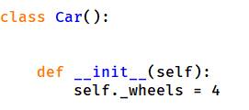
Instantiation, instance variables and methods
__init__ ()
When a new object instantiated, constructor method is called.
Use the object to call instance methods. ( obj.method() )
Instance variables also can be visited using object. ( obj.variables )
The first arguments of the instance method is always self. Meaning the object itself. Use this self to visit the instance variables, or instance methods.

Slide 4
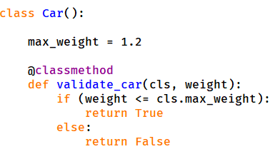
Class variables and class methods
Class variables and class methods do not need an instance. They are universal for the class (thus all instances).
Use decorator @classmethod to define the function. The first arguments of the classmethod is cls which is the class itself.
Used for common data and method for the class. (means for all instances)

Slide 5
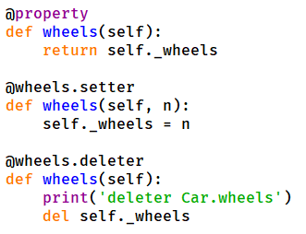
encapsulation
Normally for OOP programming, will not directly allow outside to visit internal variables. Python by default allow this kind visit.
Call use @property to change this, and provide getter, setter, deleter method for outside to use.
The related instance variable name should start with ‘_’, this will tell everybody that this variable should not be directly accessed and changed, instead should only be through intermediaries (getters and setters)

Slide 6
inheritance
Vehicle
Car
Truck
Motorcycle
Inheritance, sometimes also call subclassing.
A car is a vehicle, a truck is a vehicle, a motorcycle is a vehicle. All of them has the property and action of vehicle can have.
An apple tree is a tree, a papaya tree is a tree, a pine is a tree
If want the sub class has the attributes of base class, in subclass __init__() need call super().__init__()
Tree
Papaya tree
Pine
Apple tree
Tree
Papaya tree
Pine
Apple tree
Fruit tree
Inheritance in programming helps easily reuse the existing code, and extend with new code if needed.

Slide 7
Polymorphism
Vehicle
Car
Truck
Motorcycle
engineStart()
Vehicle class can have methods like engineStart(), drive(), break(), etc.
Car, Truck, those inherited class can override the methods with their own version.
When you use a vehicle object (instance) to call the method name, it will be targeted to the correct version of the method.
engineStart()
engineStart()
engineStart()

Slide 8
Super() and MRO
super() can be used to call base class functions when needed. (it will travel through the MRO, each time call to find next in the MRO list)
The procedure is related with MRO. Each super call will check the MRO and resolve which method to invoke.
single inheritance, __mro__ is just the tuple of: the class, its base, its base's base, and so on up to object
with multiple inheritance, in __mro__, no class is duplicated, and no class comes after its ancestors.
for classes that at the same level of multiple inheritance they are in the __mro__ left to right.
Rule when using multiple inheritance:
Subclass appear on the left, base class on the right
When one class is on left of another class, it should be same for all other multiple inheritance

Slide 9
Can inherit from existing Python class
Python build-in class is also a class that can be used. Also can inherit from those class.
You can override the existing methods in you own definition of the new class.
list
MyList

Slide 10
Is, isinstance
list1 = []
list2 = []
list3=list1
if (list1 == list2):
print("True")
else:
print("False")
if (list1 is list2):
print("True")
else:
print("False")
if (list1 is list3):
print("True")
else:
print("False")
list3 = list3 + list2
if (list1 is list3):
print("True")
else:
print("False")
The is operator checks if identifiers are exactly referring same object. (== checks by the values of the identifiers)
The isinstance() checks if an object is an instance of the class defined.
class Foo:
a = 5
fooInstance = Foo()
print(isinstance(fooInstance, Foo))
print(isinstance(fooInstance, (list, tuple)))
print(isinstance(fooInstance, (list, tuple, Foo)))

Slide 11
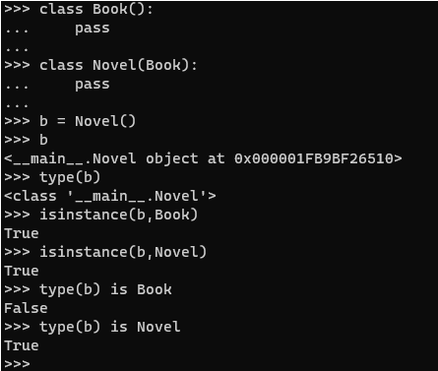
Is, isinstance
isinstance() will return True if object is a sub-class instance from some base-class.
The is operator can be used to check exact class type, used together with type().

